Slide 1


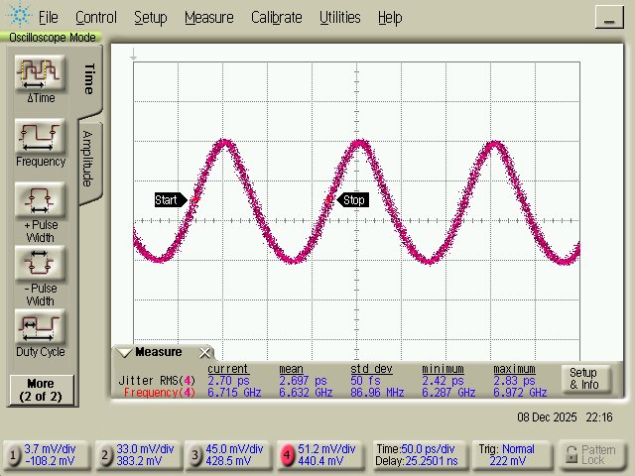
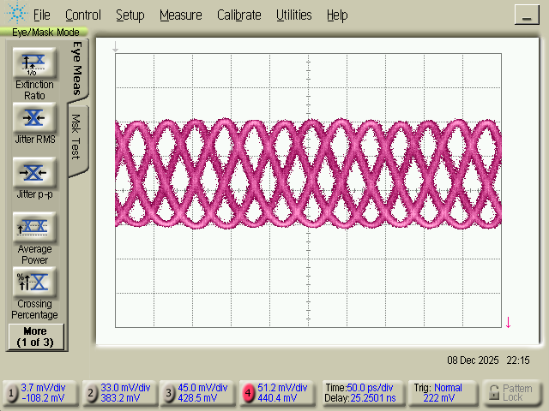
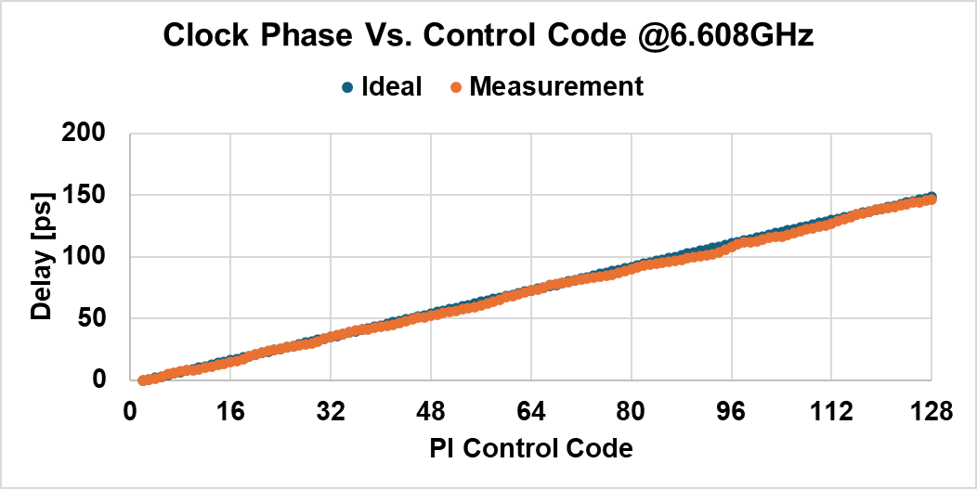
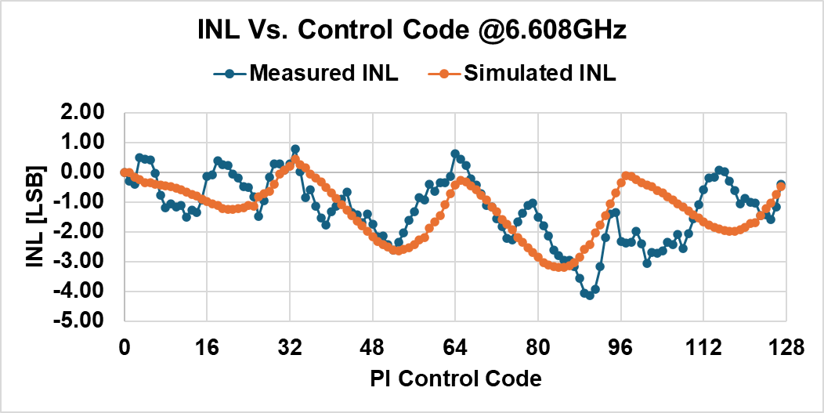
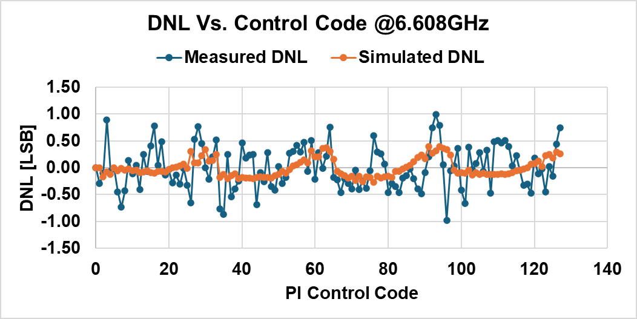
High-speed and Wide Frequency Range Phase Interpolators
for High-Speed Wireline Interface
Nguyen Viet Thinh, YoungJun Byun, and Gyungsu Byun
Department of Electrical and computer Engineering, Inha University
Abstract
This paper presents a high-speed integrating-mode phase interpolator (IMPI) integrated with an LC-VCO PLL, fabricated in 28nm CMOS. The proposed PI v1 employs a frequency-adaptive replica bias scheme to maintain optimal ramp swing across a wide operating range, enabling linear phase interpolation from 2 to 7 GHz with 7-bit resolution. The complete PLL+PI clock generator achieves an RMS jitter of 2.7 ps, DNL of 2.0 LSB, INL of 4.8 LSB, and total power consumption of 11.1 mW at 6.608 GHz, demonstrating the viability of integrating-mode phase interpolation for multi-lane high-speed wireline interfaces.
Fig. 1. PI core block diagram and quadrant-based phase sector configuration. (a) The PI core consists of four banks of 32 unit current cells with a replica bias circuit for frequency-adaptive swing control. (b) Full 360° phase coverage is achieved using four quadrature input phases through quadrant-based sector selection.
RMS Jitter = 2.7ps
37.8ps
Fig. 3. Measured output clock waveform and eye diagram at 6.608 GHz (VDD = 1.0 V, VBIAS = 0.5 V). RMS jitter of 2.7 ps is measured from the output waveform, and the overlaid eye diagram at control codes 0/32/64/96 confirms correct 90° phase rotation with an eye opening of 37.8 ps.
Fig. 2 Circuit Implementation of PI Core Block
The PI core comprises four banks of 32 unit current cells driven by quadrature input clocks. A 7-bit decoder selects the active quadrant and enables the corresponding units, while a replica bias circuit suppresses excessive ramp swing at low frequencies to preserve threshold-crossing linearity. As shown in Fig. 1, the quadrant-based architecture achieves full 360° phase coverage from only four input phases, with inactive buffers powered down to save power.
Fig. 2 details the circuit implementation: each unit cell is a current-steering pair gated by en/enb, biased by Vbp/Vbn from the replica circuit driven by external Vbias.
Fig. 3 shows the measured waveform and eye diagram at 6.608 GHz, confirming 2.7 ps RMS jitter and a 37.8 ps eye opening. The four overlaid patterns at codes 0/32/64/96 verify correct 90° quadrant-by-quadrant rotation.
Fig. 4 shows the phase transfer curve with INL and DNL. The response tracks the ideal linear curve across all 128 codes, with measured DNL of 2.0 LSB and INL of 4.8 LSB in good agreement with post-layout simulation. The periodic INL pattern reflects quadrant-boundary discontinuities, the dominant nonlinearity source in the integrating-mode architecture.
Measured Results
2.0 LSB
DNL P-P:
4.8 LSB
INL P-P:
2.7 ps
RMS Jitter:
Fig. 4. Measured phase transfer curve, INL, and DNL at 6.608 GHz. The phase response closely follows the ideal linear characteristic across all 128 control codes.
**The chip was wire-bonded to an FR4 PCB with SMA connectors for the reference clock and RF output and decoupled supply lines
Conclusion
A 28nm CMOS integrating-mode phase interpolator integrated with a 14 GHz LC-VCO PLL has been designed, fabricated, and characterized. The proposed frequency-adaptive replica bias scheme successfully maintains optimal ramp swing across a 3.5× operating range of 2–7 GHz, validating wide-range IMPI operation for the first time in silicon. The complete PLL+PI clock generator achieves an RMS jitter of 2.7 ps, DNL of 2.0 LSB, INL of 4.8 LSB, and a total power consumption of 11.1 mW at 6.608 GHz with a PI-only power of 4.3 mW at 7 GHz. These results confirm that integrating-mode phase interpolation is a viable and power-competitive approach for per-lane clock phase control in next-generation multi-lane high-speed wireline interfaces.

